Slide 1
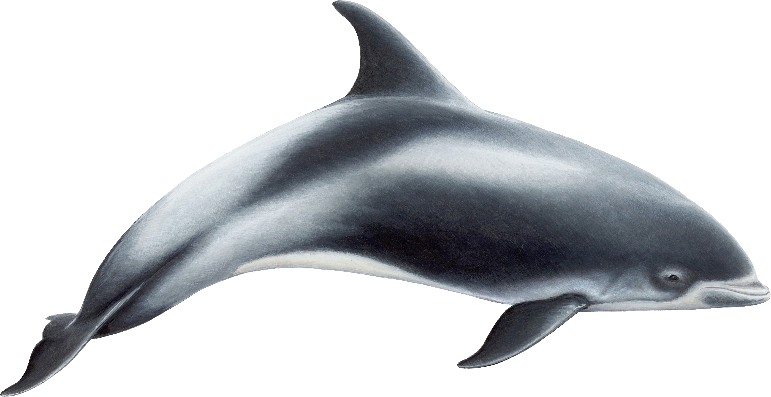
The Cove
Screening/Discussion/Log responses

Slide 2
SCREENING NOTES
Bullet-point a list of issues related to ethics/legality/safety. Consider:
Actions of individuals (protestors, activists, fisherman, officials)
filmmakers and what they choose to do/capture on film
Actions of groups

Slide 3
DISCUSS
1. The film references a quote by Margaret Mead: “Never ever depend upon governments or institutions to solve any problem. All social change comes from the passion of individuals.” Explain how that philosophy is or is not evident in the film.
2. In this film the documentary team takes an active role in the movie itself. What effect does that have on the film? Does it compromise or enhance the integrity of the film? Provide examples to explain your position.
3. We talked with Cinema Paradiso about how emotions are often manipulated in film. To what extent does that happen here, and is that justified?

Slide 4
LOG RESPONSE
2. The film has a number of purposes:
To inform about dolphin fishing industry
To challenge a long-held Japanese tradition
To prompt action against dolphin fishing industry
To atone (express sorrow/regret for) what has happened with treatment of dolphins
Other (you explain)
Choose one and discuss how effective/ineffective the film was in achieving the goal. Think, too, how the genre of documentary (its modes, its tracks, its ethics (or lack thereof) allows the purpose to be achieved/prevents the purpose from being achieved.

